Slide 1
Lecture Notes
Mode, Median, Mean and Range
Prof. Xin, Ke
OER – www.helpyourmath.com

Slide 2
Mode
The number which appears the most frequent in a set of numbers.
Example
3, 5, 3, 7, 15 – Mode is 3
No Mode – if all the numbers occur the same amount of times
Example
2, 4, 7, 5 – NO Mode
More than one mode – if more than one number is the most frequent.
Example
2, 4, 3, 2, 4 – Mode are 2 & 4

Slide 3
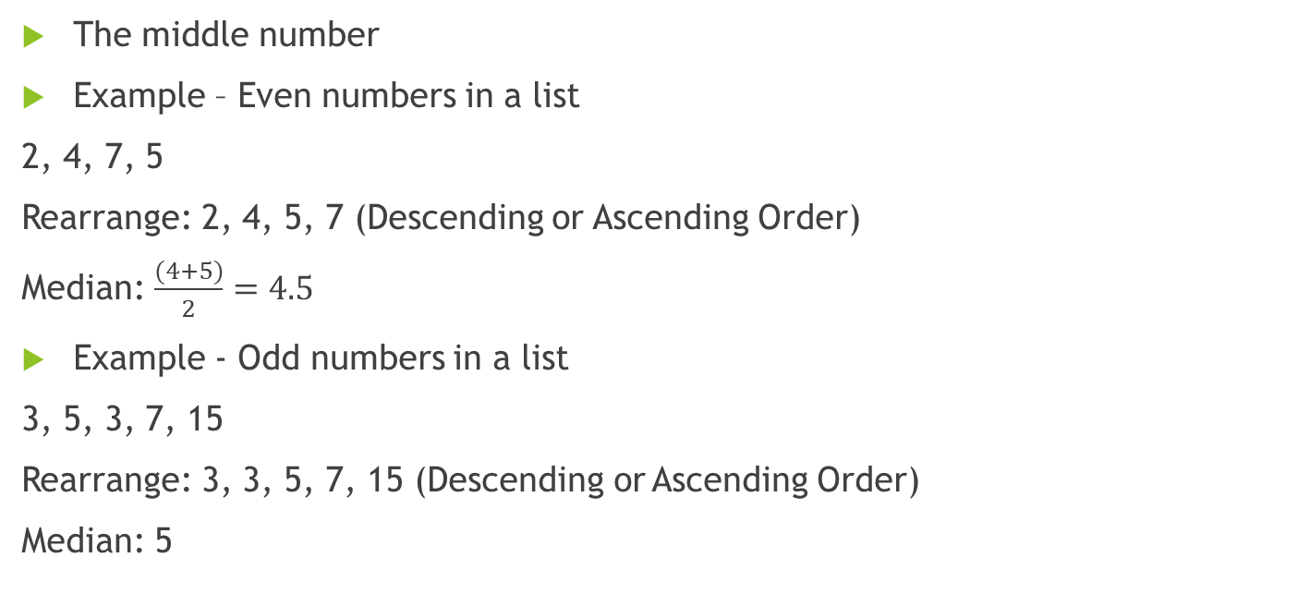
Median
The middle number
Example – Even numbers in a list
2, 4, 7, 5
Rearrange: 2, 4, 5, 7 (Descending or Ascending Order)
Median: $\frac{(4+5)}{2}=4.5$
Example - Odd numbers in a list
3, 5, 3, 7, 15
Rearrange: 3, 3, 5, 7, 15 (Descending or Ascending Order)
Median: 5

Slide 4
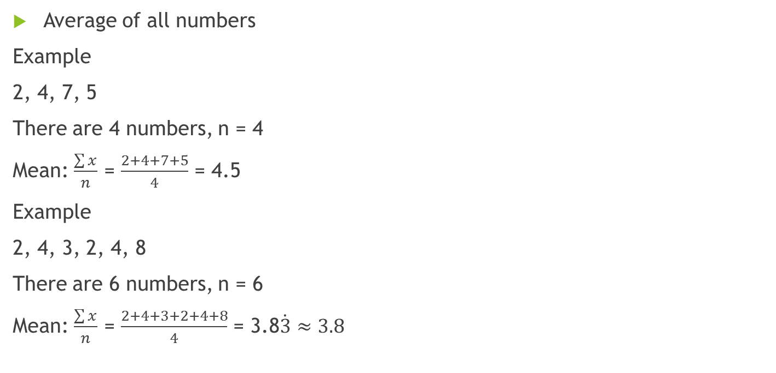
Mean
Average of all numbers
Example
2, 4, 7, 5
There are 4 numbers, n = 4
Mean: $\frac{\sum{x}}{n}$ = $\frac{2+4+7+5}{4}$ = 4.5
Example
2, 4, 3, 2, 4, 8
There are 6 numbers, n = 6
Mean: $\frac{\sum{x}}{n}$ = $\frac{2+4+3+2+4+8}{4}$ = 3.8$\dot{3}$ $≈3.8$

Slide 5

Range
Difference between highest and lowest numbers
Range = highest number $−$ lowest number
Example
2, 4, 7, 5
Range: 7(largest) – 2(smallest) = 5

Slide 6
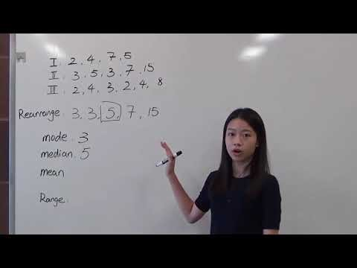
Questions?
Video

